Slide 1
Process in linux
CONG TY TIN HOC THIEN VY – THIEN VY COMPUTER

Slide 2
CONTENT
PROCESS ID
PROCESS MEMORY LAYOUT
VIRTUAL MEMORY MENAGEMENT
STACK AND STACK FRAME
COMMAND LINE ARGUMENT
ENVIRONMENT VARIABLES
PROCESS CREATION
PROCESS TERMINATION
MONITORING CHILD PROCESS
PROGRAM EXECUTION

Slide 3
Process id and parent process id
Process ID
Uniquely identifies the process on the system
Used by varieties of system call like kill
Limited to 32767
Parent Process ID
Process create child process
pstree
pid_t getpid(void);
pid_t getppid(void);
pstree command

Slide 4
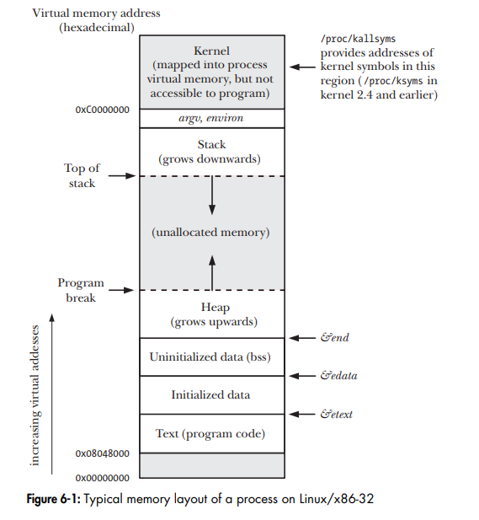
Process Memory layout
Text segment
Machine-language instructions of program run by the process
Read-only area that process don’t accidentally modify it own intructions via bad pointer access
When multiple process run the same program, text segment shareable so that a single copy of program code can be mapped into virtual address of all of processes
Initialized data segment
Global and static variables that explicitly initialized
Uninitialized data segment
Global and static variables that explicitly initialized

Slide 5

Process Memory layout
Stack
Dynamically growing and shrinking segment containing stack frame
One stack frame is allocated for each currently called function
One frame store local variables (automatic variables), argument and return value
Heap
Dynamically allocation by run time
Size command

Slide 6
Virtual memory management
To make efficient use of both the CPU and RAM by exploiting a typical property of most programs : Locality of refrence
Two kinds of locality
Spatial locality
The tendency of program to reference memory addresses that recently access
Temporal locality
The tendency of program to reference memory addresses that access recent past (due to loop)

Slide 7

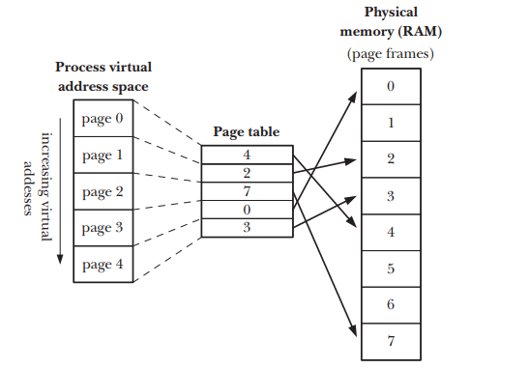
Virtual memory management
Virtual memory split memory used by each program into small fixed size unit called pages
Only some of the pages of a program need to be resident in physical memory page frames, these pages is called by resident-set
A reserved-area of disk space used to supplement the computer RAM is called swap-area
When a process references a page that is not currently resident in physical memory , a page fault occurs, kernel suspends execution of process while the page is loaded from disk into memory

Slide 8
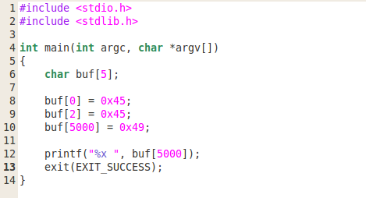
Virtual memory management
Page table
Describe location of each page in process virtual address space
Each entry in page table indicate it is currently reside on RAM or Disk
Not all address ranges in process virtual address virtual space require page-table entries, it is not necessary to maintain corresponding page-table entries
If process access in a address that is not corresponding page table entry. It receive a SIGSEGV

Slide 9
Virtual memory management
Process range of valid virtual addresses
Stack grows downward beyond limits
Memory allocated or deallocated on the heap
malloc or free
Shared memory attach or detached
shmat or shmdt
Memory mapping mapped or unmapped
mmap or munmap

Slide 10
Virtual memory management
Advantages
Process isolated from other
One process cannot read or write memory of other process or kernel
Accomplished by having the page-table entries for each process point to distinct sets of physical pages in RAM
When appropriate, two or more process can share memory
Multi-process execute the same program can share single copy of program code as multiple process run the same binary or load the same share library
IPC to communication between process
Accomplished by having page-tables entries in difference process refer to same page of RAM
Easy to implement memory protection
by allow some processes can readable, writeable or executable on some page-table entries
Programmer don’t need to concern about physical layout of program
All part of program reside in memory then program run faster and memory capacity exceed physical memory

Slide 11
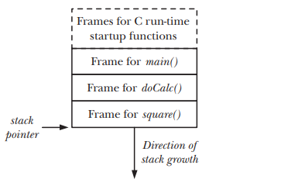
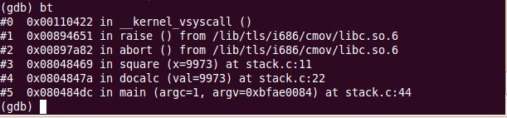
Stack and stack frame
Stack pointer
Special purpose register track the current top of stack
Each time a function is called , an additional frame is allocated on stack, this frame is remove when function returns
User stack
Include function argument and local variables
Automatic variable vs static variable
Call linkage information
Each function use certain CPU register (PC, EAX), each a function call another , a copy of these registers saved in the called function stack frame so that function return
A function call itself recursively, it has multiple stack frame

Slide 12
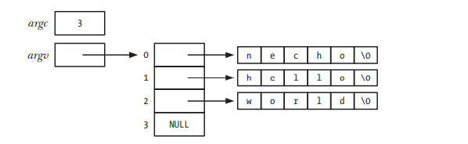
Command line argument
main(int argc, char *argv[])
argc
How many command line argument there are
argv
argv[0] is name of program
convert argument to number by strtol or atoi
use getopt library
See command line argument of a process
/proc/PID/cmdline

Slide 13
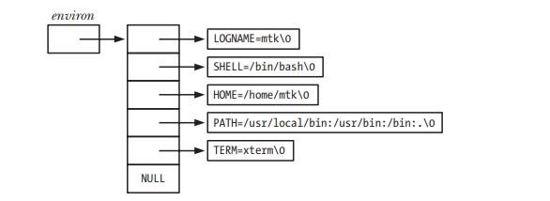
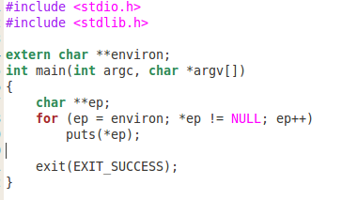


Environment VARIABLES
Environment list
Array of strings associated for process
When a process created, it inherit a copy of parent environment
A common use of environment variables is in the shell. By placing values in shell environment, the shell ensure it will pass to process that execute in the shell
export command
export
export PATH=$PATH:/path_to_dir
bashrc
PATH and LD_LIBRARY_PATH environment
environ global variables
APIs

Slide 14
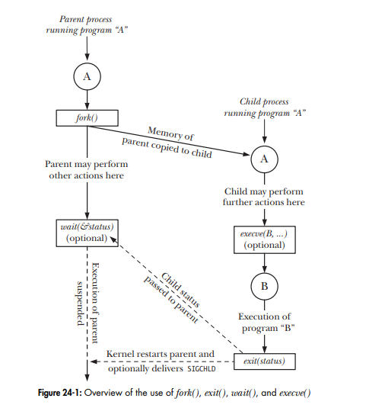
Process creation- overview of basic system call
fork()
Allow parent process create child process
Child obtains copies of the parent’s stack, data, heap and text segments
exit(status)
Terminate a process, making all resources like memory, open file descriptor used by process now available for kernel reallocation
status determines the termination status for process
wait(status)
If process is not terminated , wait will suspends execution of the process until one of children has terminated
If process terminated, wait will return immediately with child termination status
execve(pathname, argv, envp)
Loads program into process memory with argument argv and environment list envp
The existing program text is discarded, the stack, data, heap segments are freshly created

Slide 15

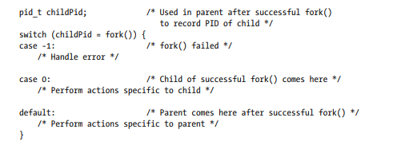
Creating new process with fork
Creating new process is useful way of dividing tasks as network server receive request from multi-clients
fork creates a new process, the child, that is an almost exact duplicate of calling process, the parent. When fork completed, two process exist and execution of two process is continuing
Two processes are executing the same program text but they have separate copies of stack, data and heap segment
The child’s stack data and heap segment are initially exact duplicates of corresponding part of parent memory.
After fork, each process can modify the variables in stack, data, heap segment without affecting the other process
fork will return child process id to parent process, 0 to child process and -1 if something error

Slide 16
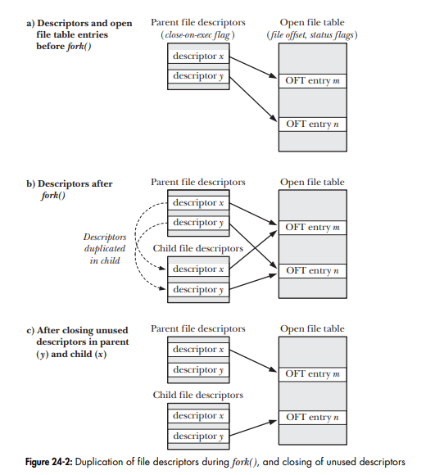
File sharing between parent and child
After fork, the child receives duplicate of all of the parent file descriptor, it mean parent and child refer to the same open file descriptor
All attributes of open file is shared between the parent and child
For example, the child modify file offset, this change is visible through the corresponding descriptor in parent
If the parent and the child both writing the file, sharing offset ensure that the two processes don’t override each other’s output
However it is not prevent the output of two process es from being randomly intermingled
The code should close unused descriptor

Slide 17
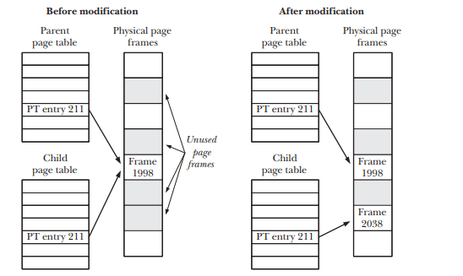
Memory sematic of fork
The wasteful copy of parent text, data, heap and stack
Especially after fork is exec
Exec will discard current text, data, heap, stack and replace by its own program
Kernel use some techniques to avoid such wasteful copying
With text segment, this area is read-only, so that process cannot modify its own text segment, then
All entries in per-process per-tables in child refer to same virtual memory page frame already used by parent
For pages in data, heap and stack, kernel employs copy-on-write technique

Slide 18
Race conditions after fork
Parent scheduled first in almost times but not guarantee
/proc/sys/kernel/sched_child_runs_first work?
Several way to guarantee the order of process of parent and child
Semaphore
File lock
Messaging through IPC
Signal

Slide 19
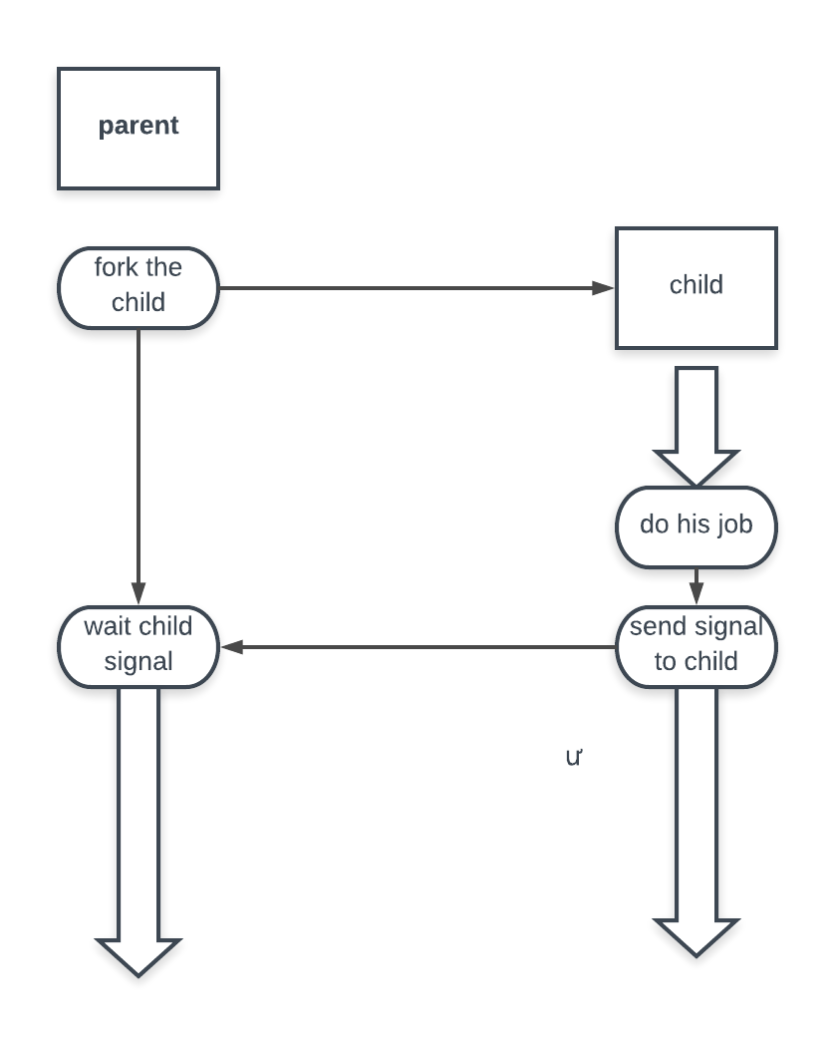
Avoid race condition by synchronizing with signal
Parent wait his child finish the job and process

Slide 20
Process termination – TERMINATING A PROCESS WITH EXIT AND _EXIT
Exit a process
Two way for terminating a process
Normal way through exit or program finish
Abnormal way through receiving a signal
Actions are performed by calling exit
Exit handler
stdio buffer stream flush
_exit system call involved
Process termination detail
Open file descriptor, directory streams … are closed
File lock held by process are released
Attached share memory are detached
Semaphores are closed
Message queue are closed
Memory lock is removed
Memory mapping is unmapped

Slide 21

Exit handler – atexit/ON_EXIT
Cleanup action
Some libraries or application need to perform cleanup action automatically when process exit
Linux provide a programmer supplied function that is registered in lifetime of process and automatically called during normal process terminate by call exit
Exit handler is not called if a program call _exit() system call directly or if process terminated abnormal by a signal
Exit handler add func to list exit function, these func no have argument and return value
When a program invoke exit, these func are called in reserve order of registration
If one of exit handler call _exit or raise a signal, process will terminate and ignore the remaining exit handler
A child process inherit parent exit handler registration after fork
When a process perform exec , all exit handler registration is remove

Slide 22
Interaction between fork, stdio buffer and exit
Duplicate output when redirect output
Flush stdout before fork
Call setbuf to disable buffering on stdio stream
One process call exit, other call _exit system call

Slide 23
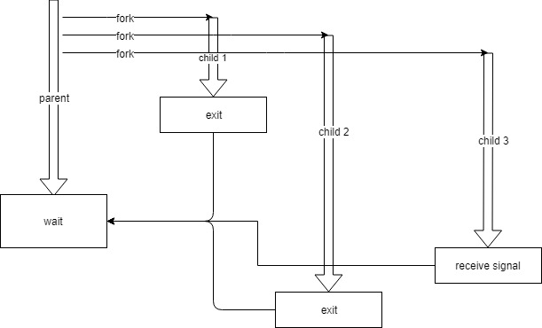
Monitoring child process – WAIT system call
Waiting on child process
wait system call
Wait one of the children of calling process terminate and return termination status to status argument
If no child of calling process has yet terminated, the call blocks until one of children terminate
If one of children terminate already, wait return immediately
If status is not NULL, information about how the child terminated is returned in the status argument
The kernel adds the process CPU times and resource usage statistic to running totals for all children
Wait return the process id of children process that has terminated

Slide 24
waitpid system call
Limitations of wait
Parent cannot wait a specific children
If no child has yet terminate, wait always block, sometime, program need parent do some other work
Parent don’t know when child receive a SIGSTOP
pid argument enables the selection of the child to be waited for
If pid > 0, wait process has process id is pid
If pid = 0, wait any child
Status argument as wait
Options
WUNTRACED return when child receive a SIGSTOP signal
WCONTINUED return when a stop process is resume
WNOHANG return immediately if children that has process id is pid no have state change (poll)

Slide 25
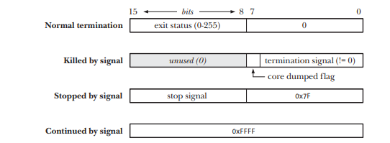
value of status
Status value returned by wait and waitpid allow distinguish following event of the child
The child terminating by calling exit
The child terminated by the delivery of an unhandled signal
The child stop by signal SIGSTOP
The child resume by signal SIGCONT
Macro
WIFEXITED(status) – normal exit
WIFSIGNALED(status) –unhandled signal
WIFSTOPPED(status) – signal stop
WIFCONTINUED(status) –signal continue

Slide 26
Orphans and zombieS
Who become an parent of orphaned child?
init process –pid 1
getppid function
What happen if a children terminate before its parent call wait
Parent be permitted call wait even when children terminated, kernel maintain terminated children at zombie state
Almost children resource already release back and reallocate for other process, only info in kernel process table entry that include child pid, termination status and resource usage status
When parent call wait, this entry removed from table
Otherwise, this entry exist forever until parent process terminated

Slide 27
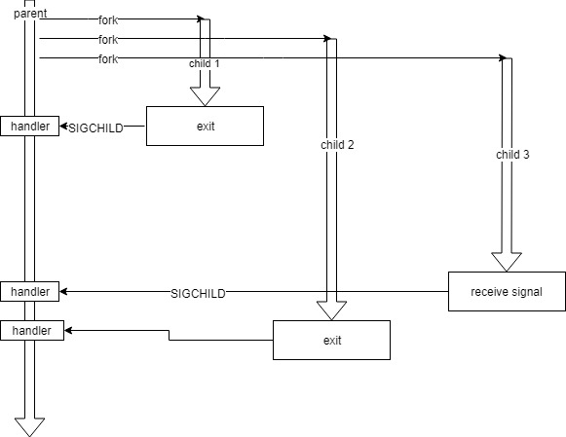
Sigchild SIGNAL
Child process terminated
An asynchronously event that parent is not predict
Parent can call wait and waitpid in blocking (without WNOHANG)
Parent can call waitpid in nonblocking (with WNOHANG)
Both blocking or non-blocking is inconvenient. Then child send SIGCHILD to parent each time it terminate

Slide 28
Program execution
Executing a program with execve system call
Load a program into a process memory
Old program is discarded and process’s stack, data, heap, text segment are replaced by new program
Most frequent use of execve is in the child produced by a fork
Pathname : name of binary
argv : command line path to bin
envp: environment list

Slide 29
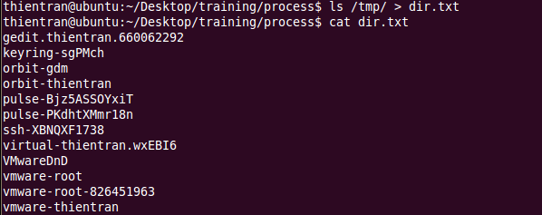
FILE DESCRIPTOR AND EXEC
Open file descriptor through exec
These files remain open across the exec and available for new program
Shell take advance of this feature to handle I/O redirection for program that it execute.
i.e. ls /tmp > dir.txt
Fork the child, pass the command
Child open dir.txt so that it has file descriptor 1
Close stdout, the open file descriptor of dir.txt
Dup2 fd of dir.txt and stdout
Exec the ls command, ls write to stdout which currently is dir.txt

Slide 30
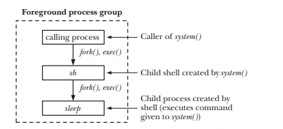
Executing in a shell command
system function
system(“ls /dev/ | grep rtc”) or system(“sleep”)
System function create a child process that involke a shell to execute command

Slide 31
Process function review
GETPID/GETPPID
FORK
EXIT
ATEXIT/ON_EXIT
WAIT/WAITPID
EXECVE
SYSTEM

